Slide 1





Slide 2



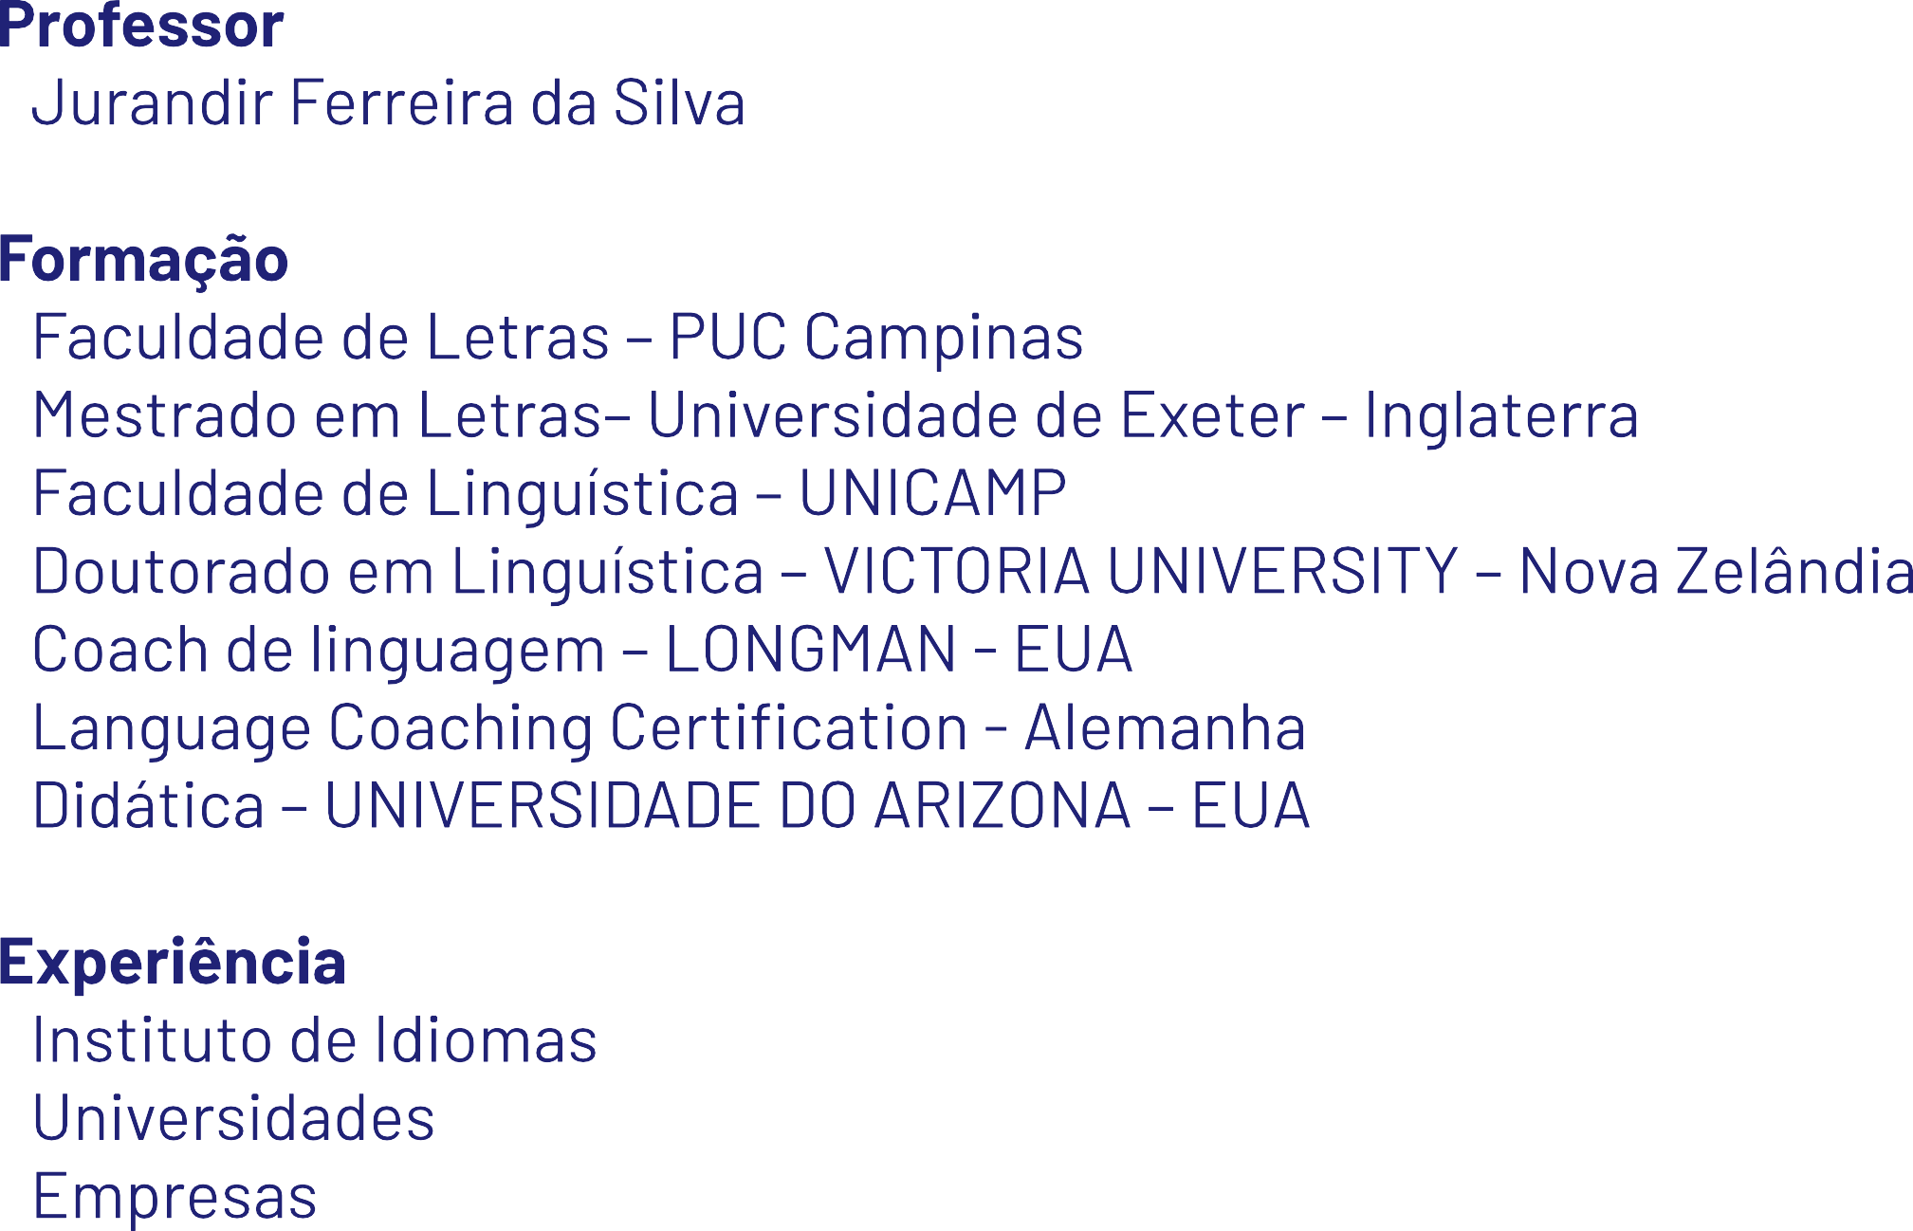

Slide 3







Slide 4



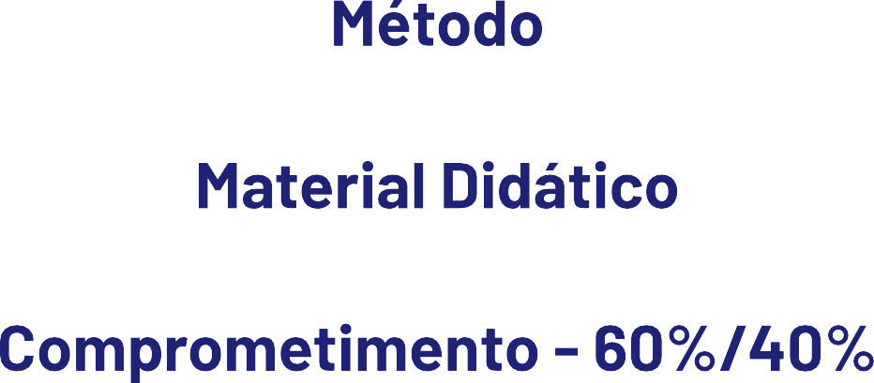

Slide 5


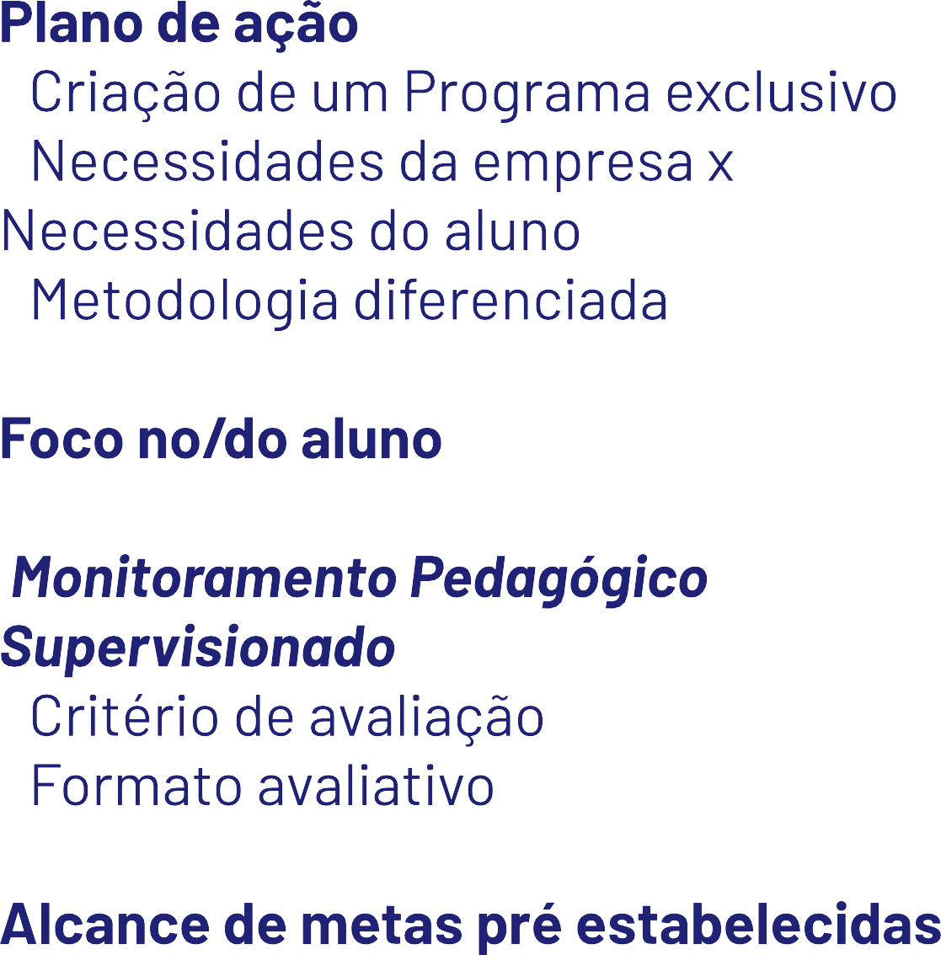


Slide 6







Slide 7

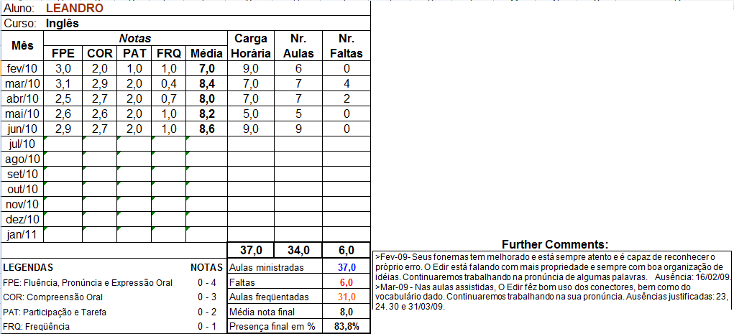
10,0
9,0
8,0
7,0
6,0
5,0
4,0
3,0
2,0
1,0
fev/10 mar/10 abr/10 mai/10 jun/10 jul/10 ago/10 set/10 out/10 nov/10 dez/10 jan/11

Slide 8
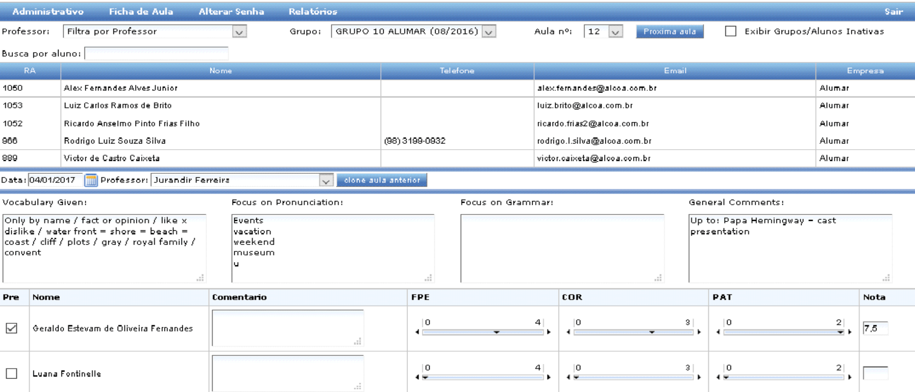

Slide 9
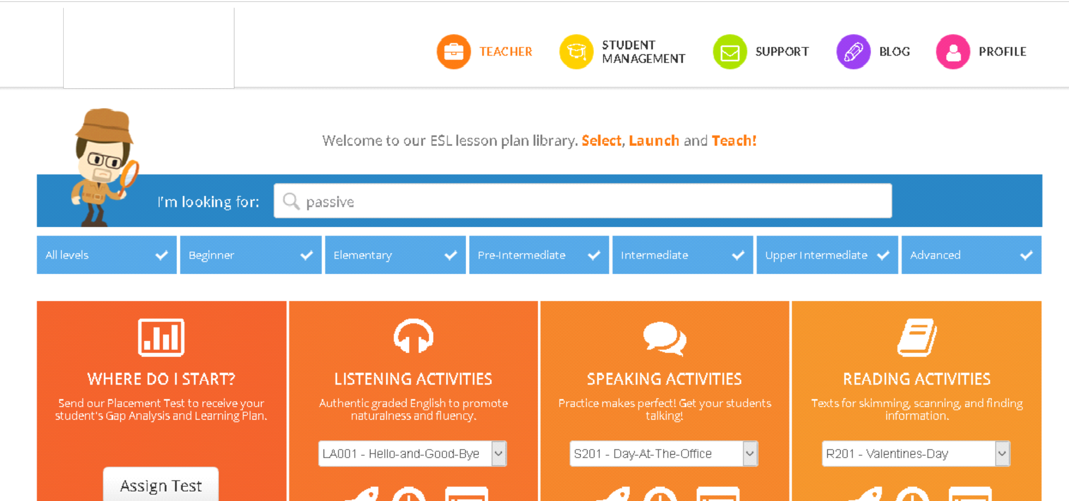

Slide 10



Slide 11









Slide 12



















Slide 13








